Slide 1
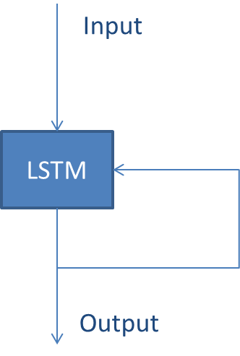
Input
LSTM
Output

Slide 2
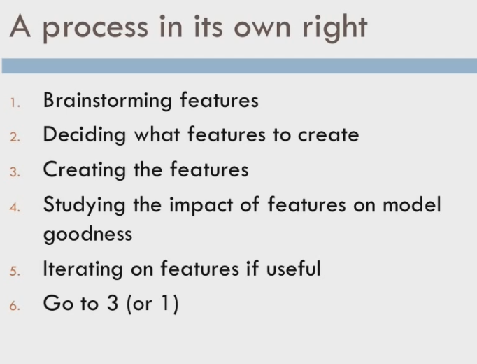
We will focus on four categories: CPU, memory, network and disk

Slide 4
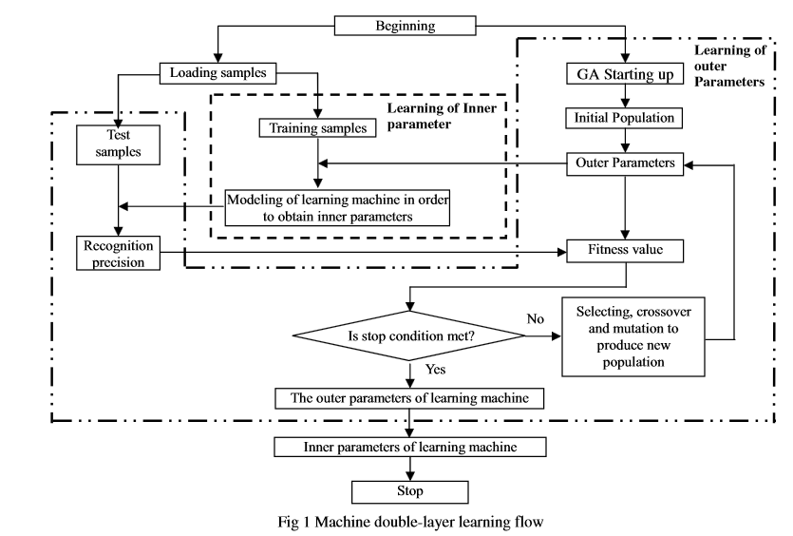

Slide 5
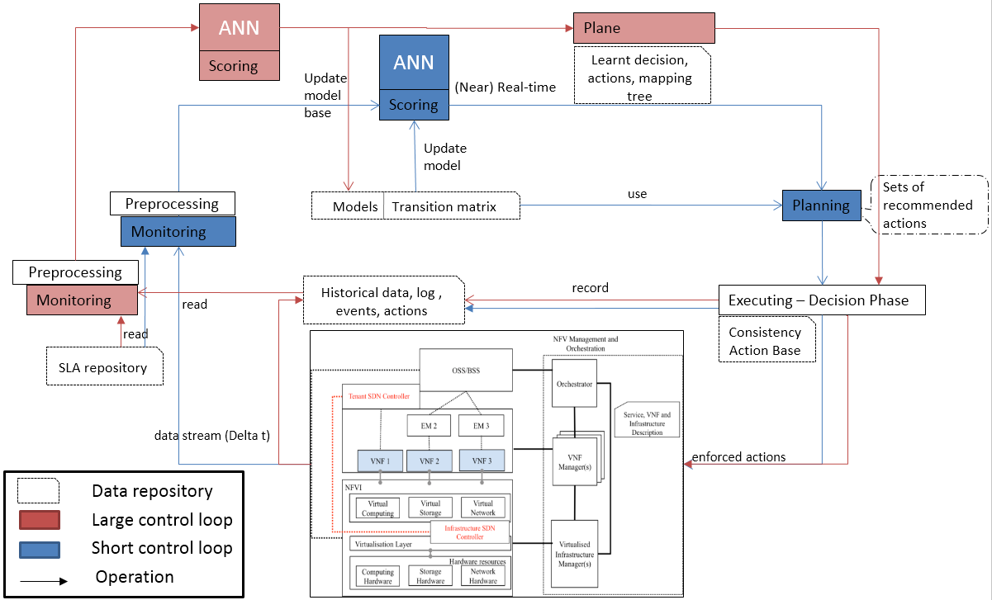

Slide 6
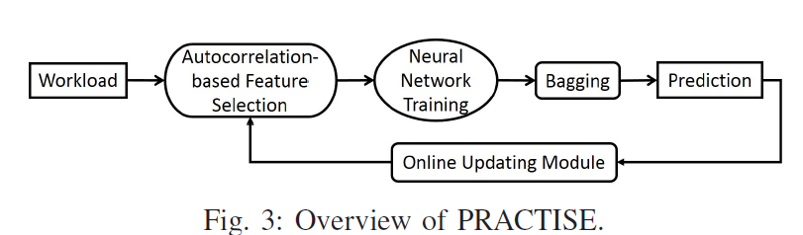
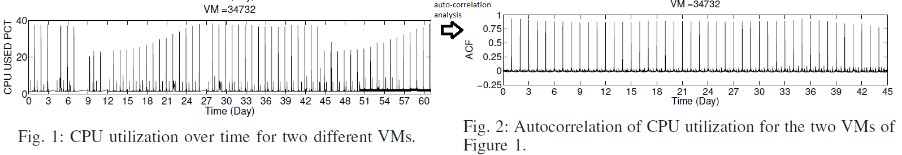
Machine Learning Pipeline concept
we split the data set randomly several times (e.g.,
20 times), and each split trains a different model. In other
words, we train a group of neutral network models by using
the same data set but with different splits. Each model has
its own prediction result. The prediction results from different
models together become a distribution of prediction results.
To compute the final prediction results from the distribution
of prediction results, we first use the 3-sigma rule [19] (e.g.,
99% confidence interval) and z-score [20] (e.g., within [-
0.85,0.85])

Slide 7
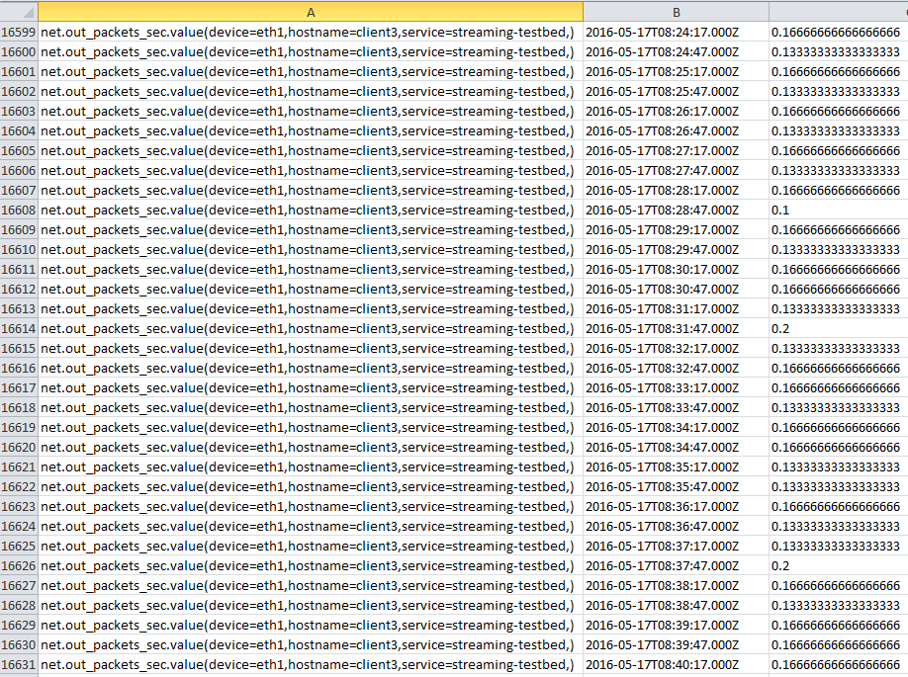
Data Sample

Slide 8
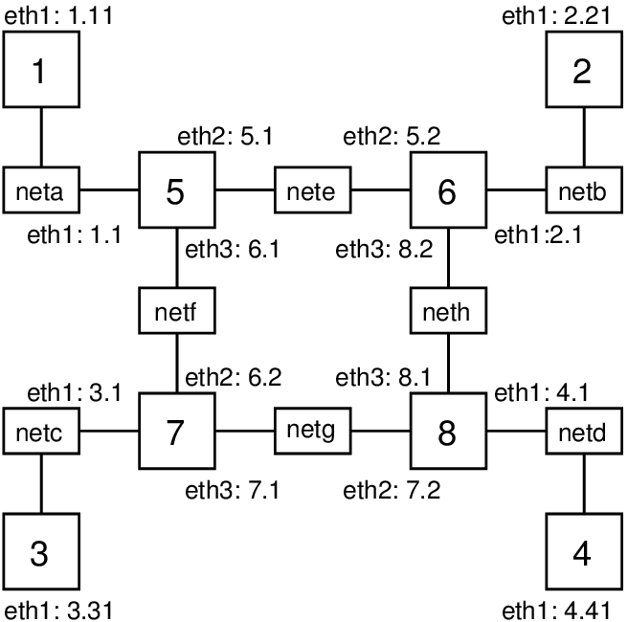

Slide 9
ML algorithm
CNSM paper 2015 concluded that 30th order polynomial model and Feed-forward Neural Network method performed the best to forecast memory and CPU usage
A popular ML evaluation metric is the squared error
there is no agreement on training or prediction window when modelling the forecasting resource

Slide 10
Definitions
Time series: a set of sequential data points or measurements collected at a regular time interval [CNSM’15].
A model : is defined as a mathematical description of a process which generates a given time series [CNSM’15]. = Math formula
Forecasting: is defined as a procedure where historical data is input into a model and prediction are produced as output of that model
SLA Violation: we should define SLA violation specifically for this paper. a proposition is : An SLA is violated, if one of its sub-part, i.e. SLO is out of the agreed threshold, for more than the agreed period of time. Generally, SLA contains penalties for such violations. If the violation occurs too frequently, the service provider may require an SLA update.
According to [Mao and humphrey] the workload can be in 4 categories each of which has its own forecasting model
Cyclic
Stable
Trending
Stochastic
Neural Networks: the Feed-Forward Neural Networks is more suited for cyclical and rending workloads ; The RNN Recurrent Neural network is more suited for stochastic workload.
ANN allows the network to remember state!
Backpropagation is a common technique for ANN training

Slide 11
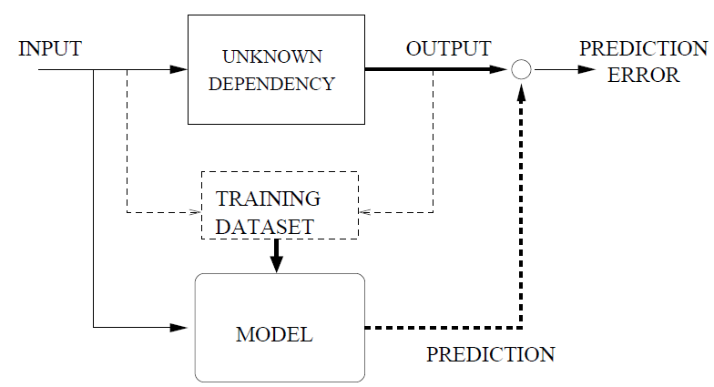
Non linear dependence between the output and the inputs

Slide 12
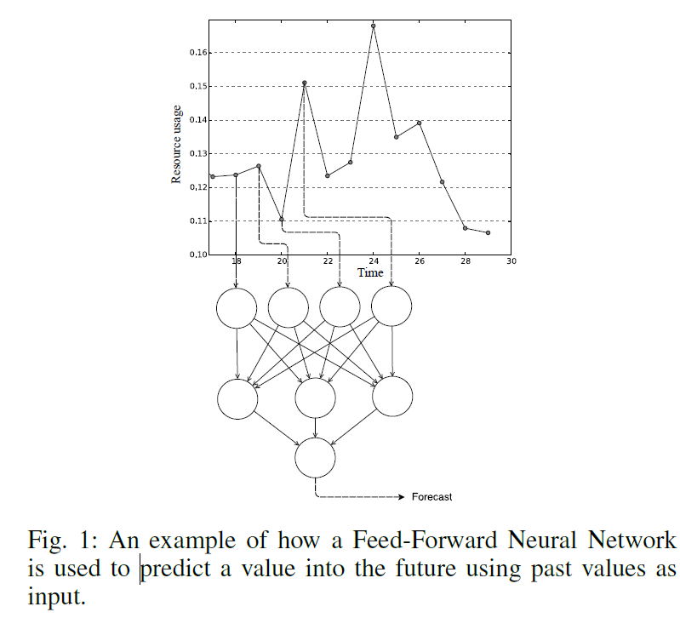

Slide 13
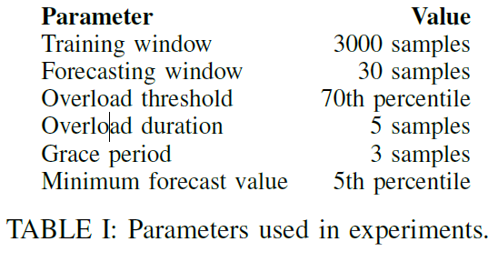
Machine Learning evaluation metric
Root Mean Squared Error (RMSE) : gives an indication of how accurately the predictions follow the true values. Scikit-learn [22] defines RMSE as the error measure corresponding to the expected value of the quadratic error loss and is calculated as the square ‘distance’ between the predicted values and the true values.
Correct estimation: A value within 10% of the true value is classified as correct
Overload estimation: Similar to Agile [5], we define overload for a specific machine as any value above the 70th percentile of all values in the that machine’s data trace
+ data point + pushing interval + N° of samples + cross validation
+ validation

Slide 14
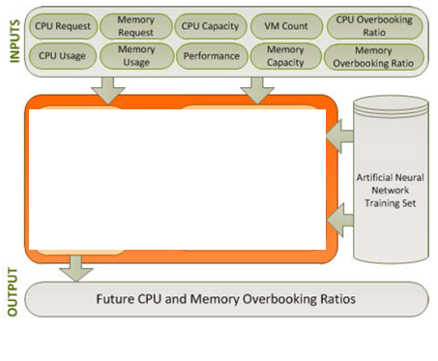
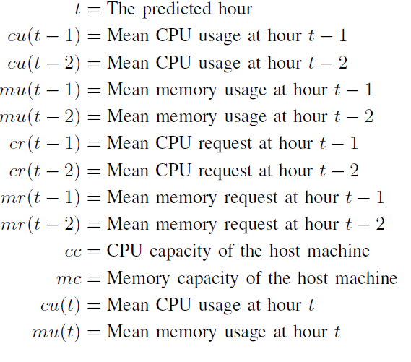
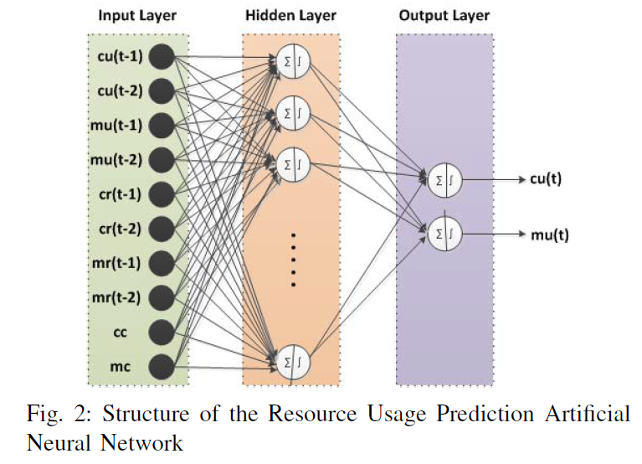
ANN for regression and time series analysis
only one hidden layer is sufficient to make any prediction [iOverbook]
29 days with Levendt-marquard back-prop algo
The best performance was with 23 neurons

Slide 15
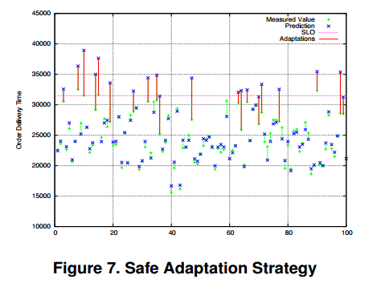
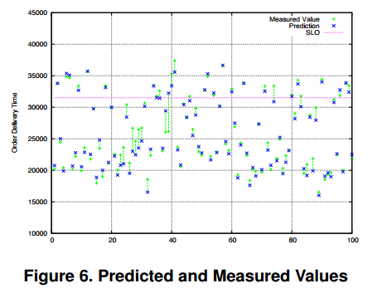
SLO and metric dependencies
SLA is a function of SLOs
SLOs are dependent of metrics (UML) example (paper for streaming)
SLO → see paper

Slide 16
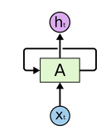
Recurrent Neural Networks
Recurrent neural networks have state memory. They are networks with loops in them, allowing information to persist
One unit of Recurrent Neural nets
Notes:
In the above diagram, a chunk of neural network, A, looks at some input xt and outputs a value ht. A loop allows information to be passed from one step of the network to the next.

Slide 17
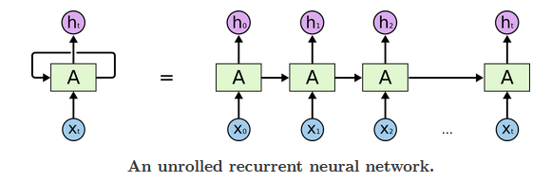
RNN unfolded
A recurrent neural network can be thought of as multiple copies of the same network,
each passing a message to a successor. Consider what happens if we unroll the loop:
Notes:
“LSTMs,” a very special kind of recurrent neural network which works, for many tasks, much much better than the standard version. Almost all exciting results based on recurrent neural networks are achieved with them. It’s these LSTMs that this essay will explore.

Slide 18
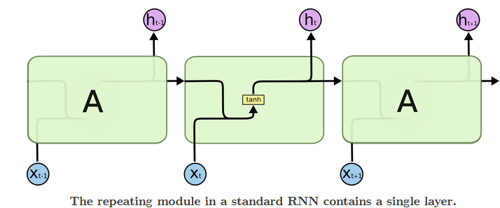
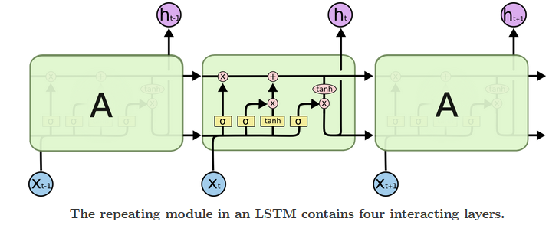
LSTM
Long Short Term Memory networks – usually just called “LSTMs” – are a special kind of RNN, capable of learning long-term dependencies
Notes:
LSTMs also have this chain like structure, but the repeating module has a different structure. Instead of having a single neural network layer, there are four, interacting in a very special way.

Slide 19
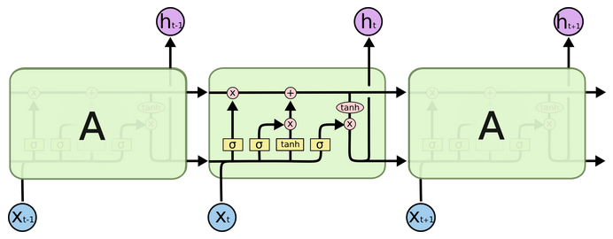
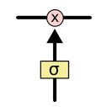

SIP_Server_Cpu(t) + err
SIP_Server_Cpu(t+1) + err
SIP_Server_Cpu(t+2) = h(t+1)
The cell state (tapis roulant)
information filter
h(t+1)
SIP_Server_Cpu(t-1)
SIP_Server_Cpu(t)
SIP_Server_Cpu(t+1)
What to forget
What to add
Notes:
Tapis Roulant
The LSTM does have the ability to remove or add information to the cell state, carefully regulated by structures called gates.
Gates are a way to optionally let information through. They are composed out of a sigmoid neural net layer and a pointwise multiplication operation

Slide 20
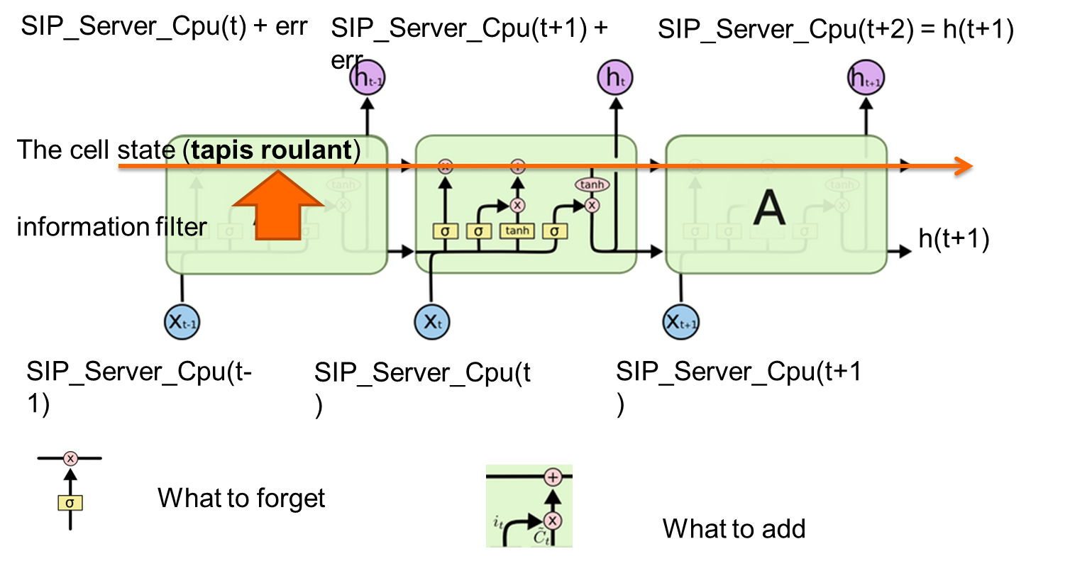

Slide 21
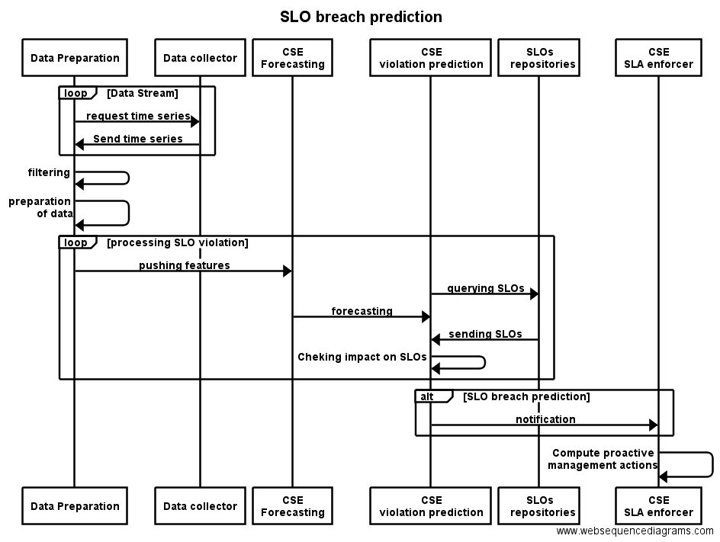

Slide 22
Data preparation
Data collector
CSE
Forecasting
CSE violation prediction
SLOs
repositories
CSE SLA enforcer
loop
[Data stream]
request time series
send time series
Filtering
Preparation
of data
loop
[Processing SLOs violation]
pushing features
querying SLOs
forecasting
sending SLOs
checking impact on SLOs
[SLO breach prediction]
loop
notification
compute proactive
management action
Data preparation
Data collector
CSE
Forecasting
CSE violation prediction
SLOs
repositories
CSE SLA enforcer

Slide 23
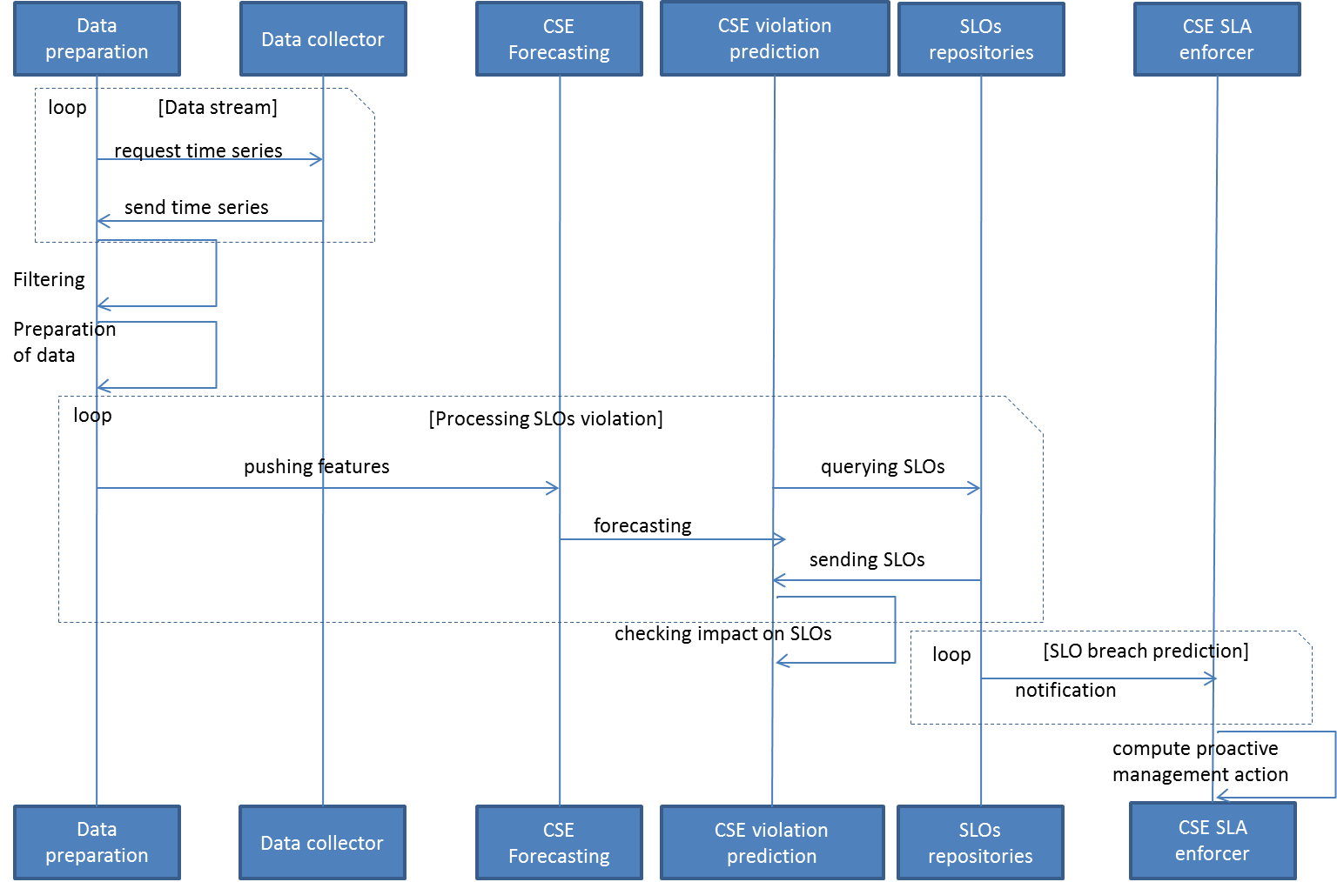
SLO Breach prediction sequence diagram

Slide 25
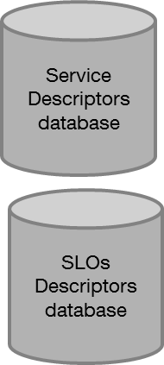

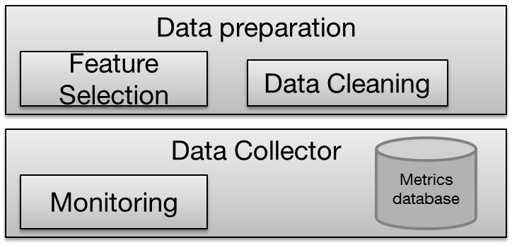

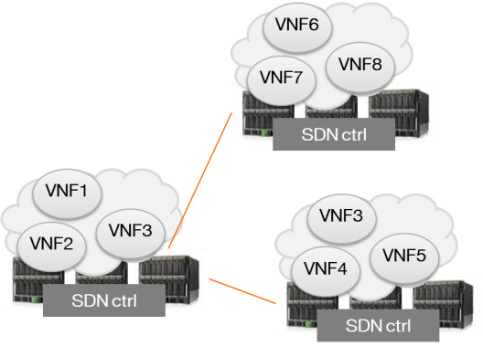
GUI
Cognitive Smart Engine
GUI

Slide 26
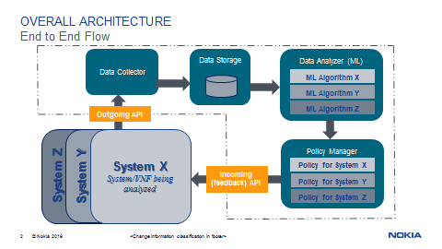

Slide 27

Service
Descriptors
database
SLA agreement
SLOs
Descriptors
database
Data preparation
Feature Selection
Data Cleaning
Data Collector
Metrics database
Monitoring
VNF6
add new raw metrics
VNF7
VNF8
edit SLA & service descriptors
SDN ctrl
VNF1
VNF3
VNF2
VNF3
VNF4
VNF5
SDN ctrl
SDN ctrl

Slide 28
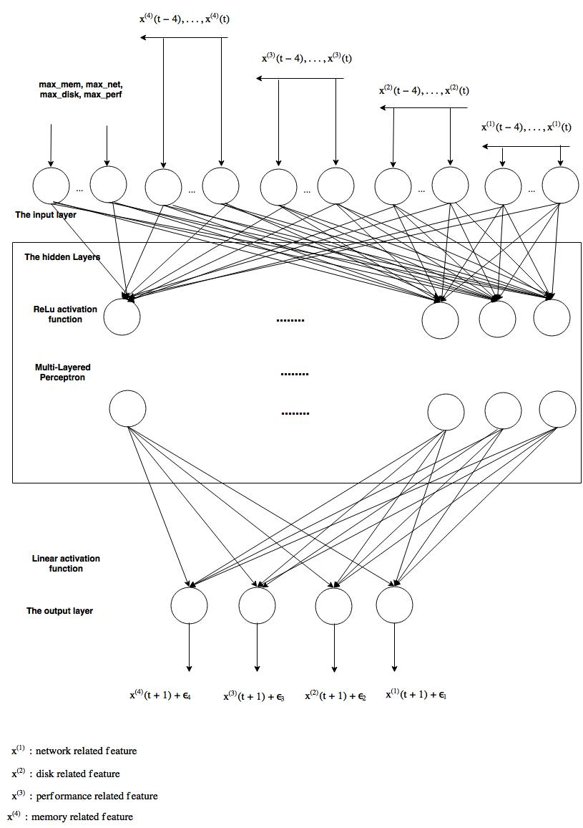

Slide 29
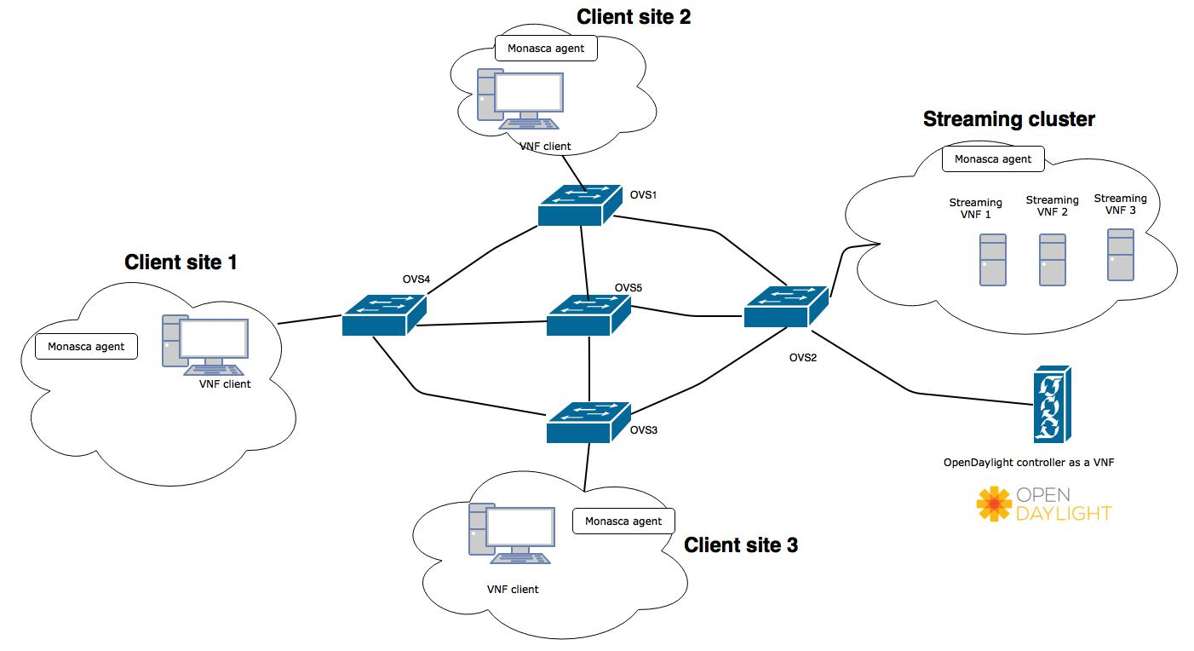

Slide 30
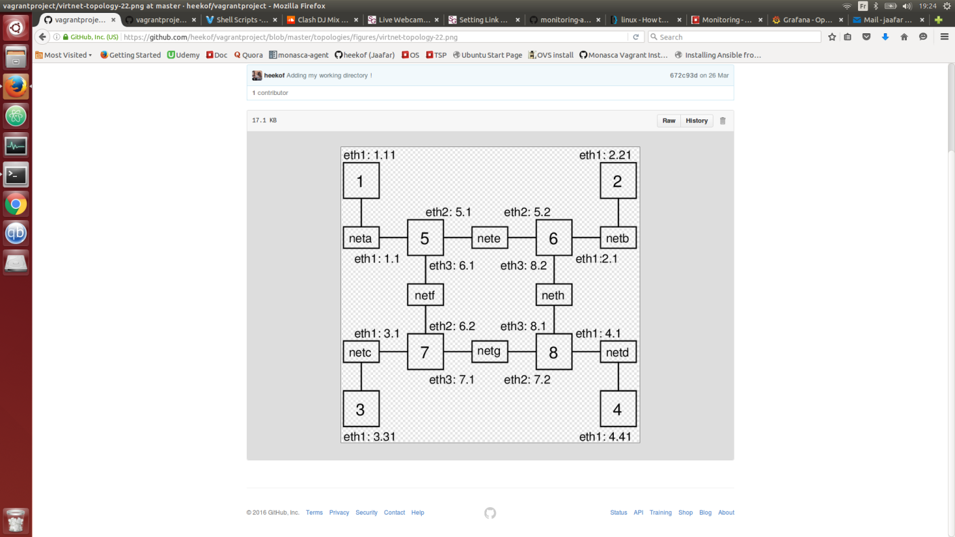
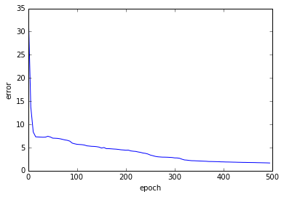

Slide 32
Client 1
Client site 1
streaming VNF 2
streaming VNF 1
Client 2
OVS1
Client site 2
streaming VNF 3
OVS4
OVS5
OVS2
Streaming cluster
OVS3
SDN controller
Client 3
Client site 3

Slide 33
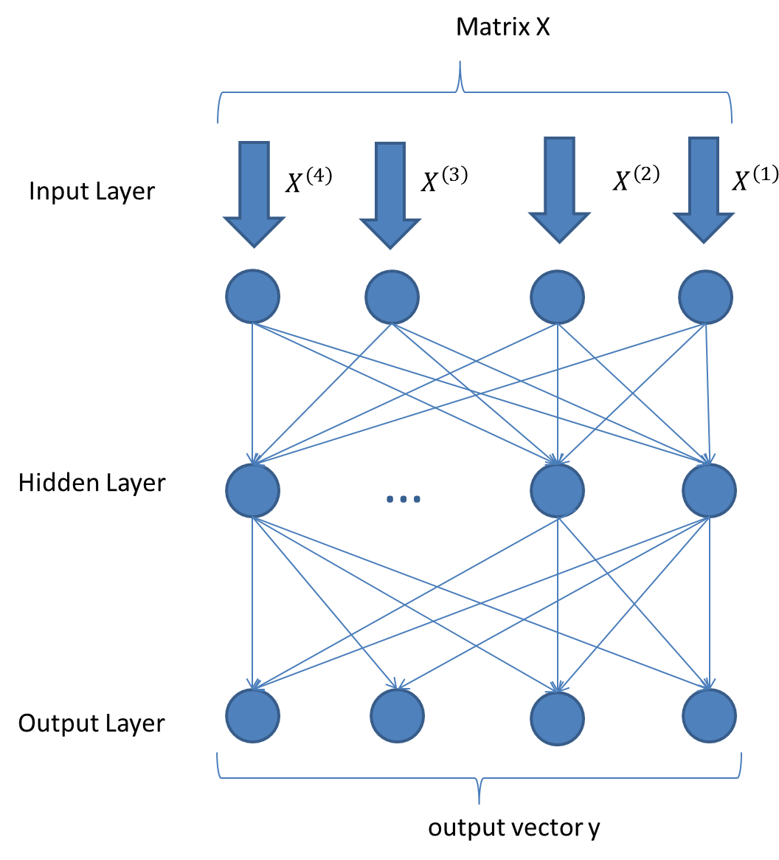
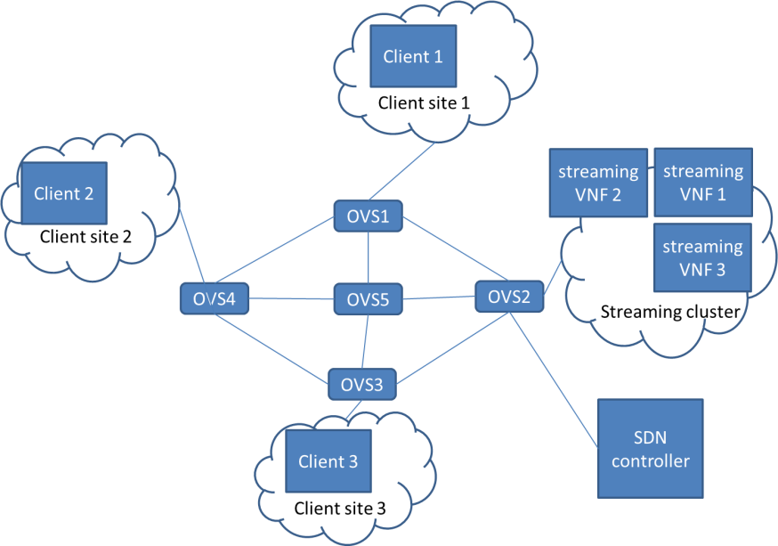

Slide 35
SLO 1
OK
SLO 1
-6
-2
0
2
6
PC 1

Slide 36
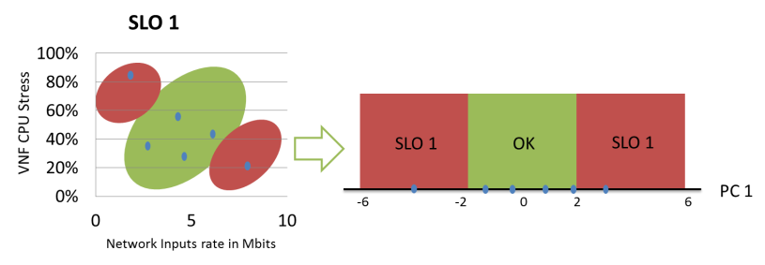

Slide 37




Matrix X
Input Layer
$$X^{\left(4\right)}$$
$$X^{\left(3\right)}$$
$$X^{\left(2\right)}$$
$$X^{\left(1\right)}$$
…
Hidden Layer
Output Layer
output vector y

Slide 38

VNF Bono
Feature 1
RNN-1
Vector 1
VNF Homer
Vector 2
Feature 2
RNN-2
VNF Sprout
Feature 3
RNN-3
Vector 3
SLA document
YAML Reader
SLO interpreter

Slide 39
Data extraction and preparation
Initialization
SLA Contract
Get Data
Reduction, Transformation
Forecasting
RNN computation
Predictions
Multiple Storage Concepts
Interpretation
D
SLO extractor
Action
Management actions
Notification

Slide 40
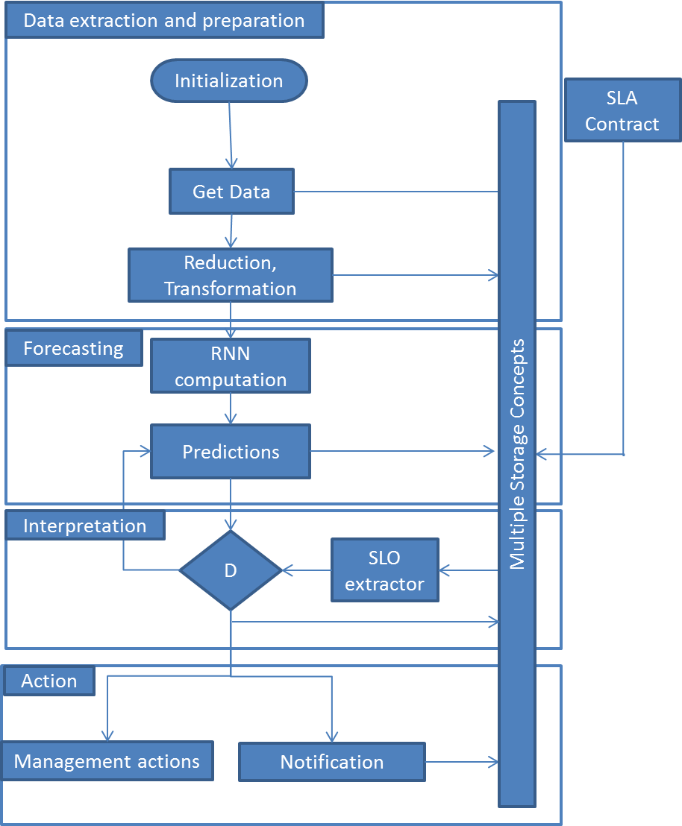

Slide 41
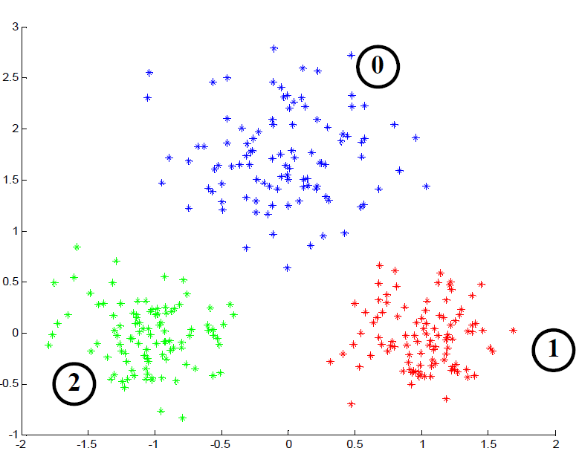
SLOV 2
SLOV 1
Average Load
Efficiency
SLOV 3
Response Time

Slide 42
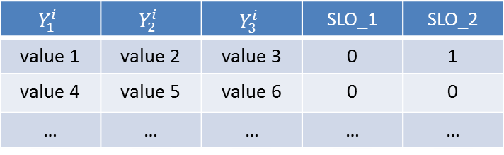



Designing an ABS (ANN-Based System)
Decision Tree
$$X_{1}^{i}$$
Multiple RNN in cascade
$$Y_{1}^{i}$$
$$X_{2}^{i}$$
$$Y_{2}^{i}$$
Merger
$$X_{3}^{i}$$
$$Y_{3}^{i}$$
$$Y_{1}^{i}$$ | $$Y_{2}^{i}$$ | $$Y_{3}^{i}$$ | SLO_1 | SLO_2
value 1 | value 2 | value 3 | 0 | 1
value 4 | value 5 | value 6 | 0 | 0
… | … | … | … | …
SLA contract
SLO extractor
SLA :
SLO 1
SLO 2
SLO 3
binder engine
Notification
Dashboard
Policy engine

Slide 43
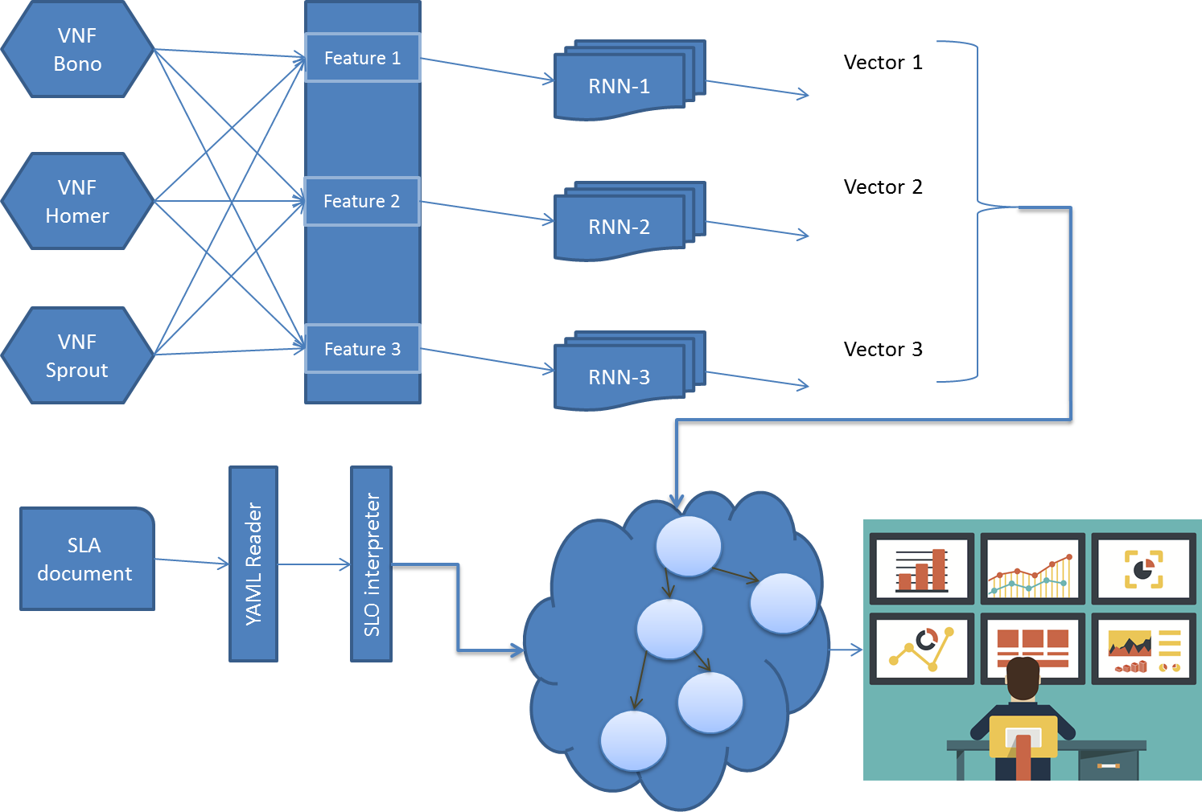

Slide 44
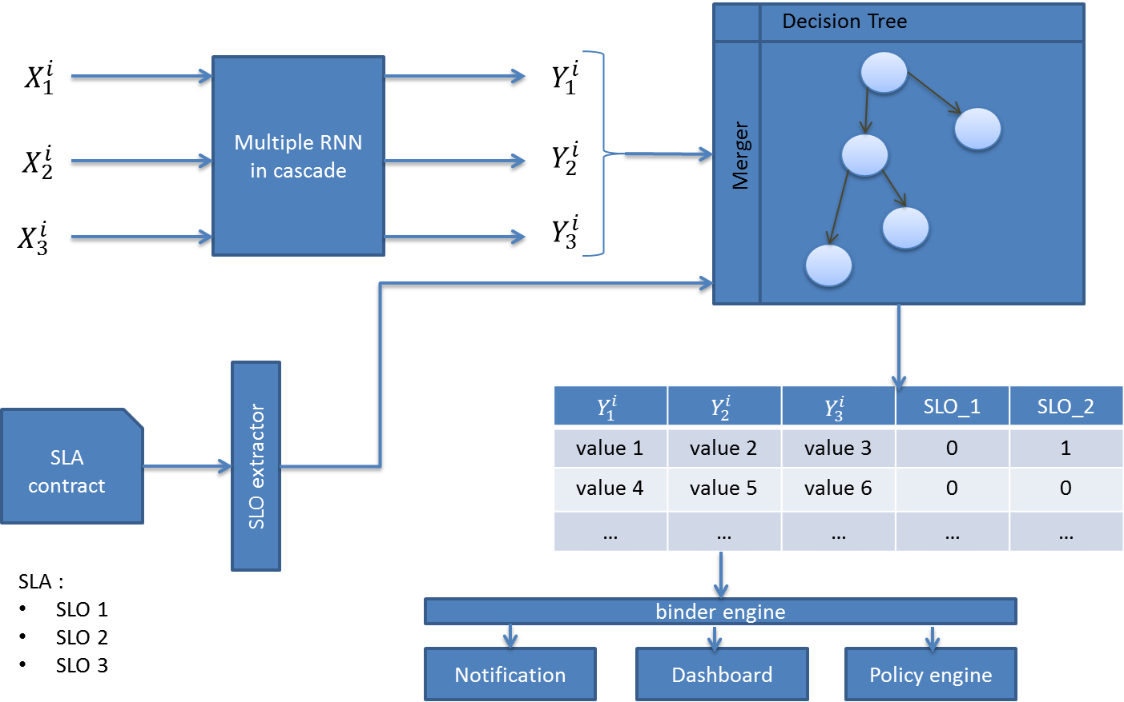

Slide 45
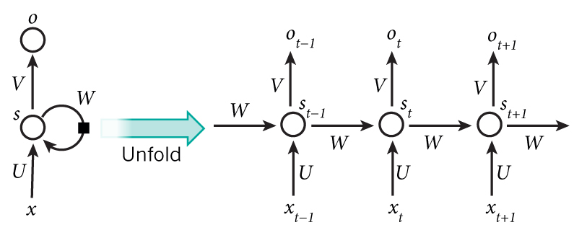
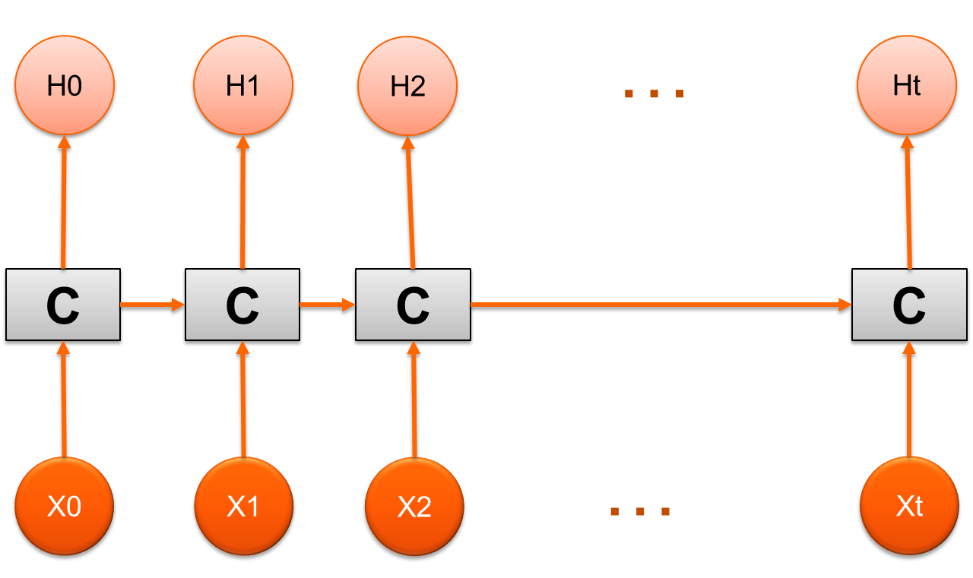
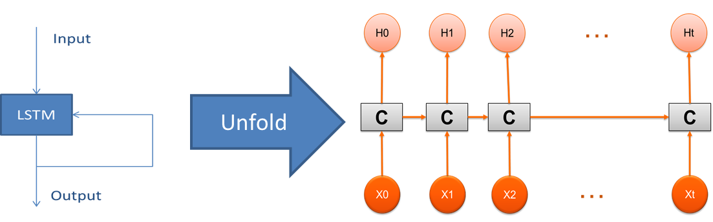
Unfold

Slide 46
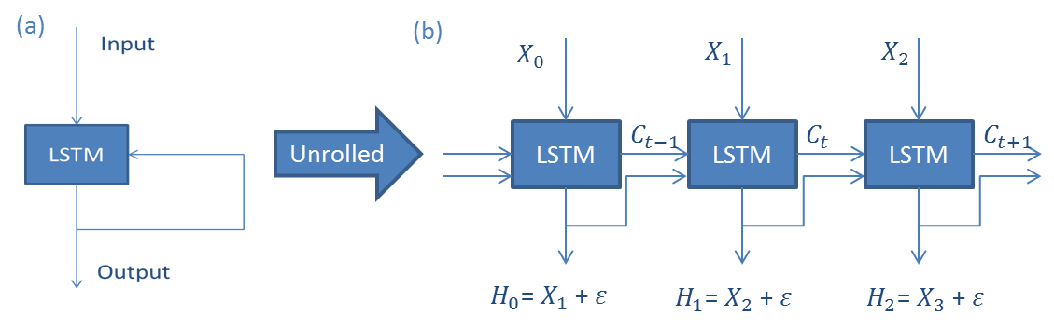









(a)
(b)
$$X_{0}$$
$$X_{1}$$
$$X_{2}$$
Unrolled
LSTM
$$C_{t−1}$$
LSTM
$$C_{t}$$
LSTM
$$C_{t+1}$$
$H_{0}$= $X_{1}$ + $ε$
$H_{1}$= $X_{2}$ + $ε$
$H_{2}$= $X_{3}$ + $ε$

Slide 47
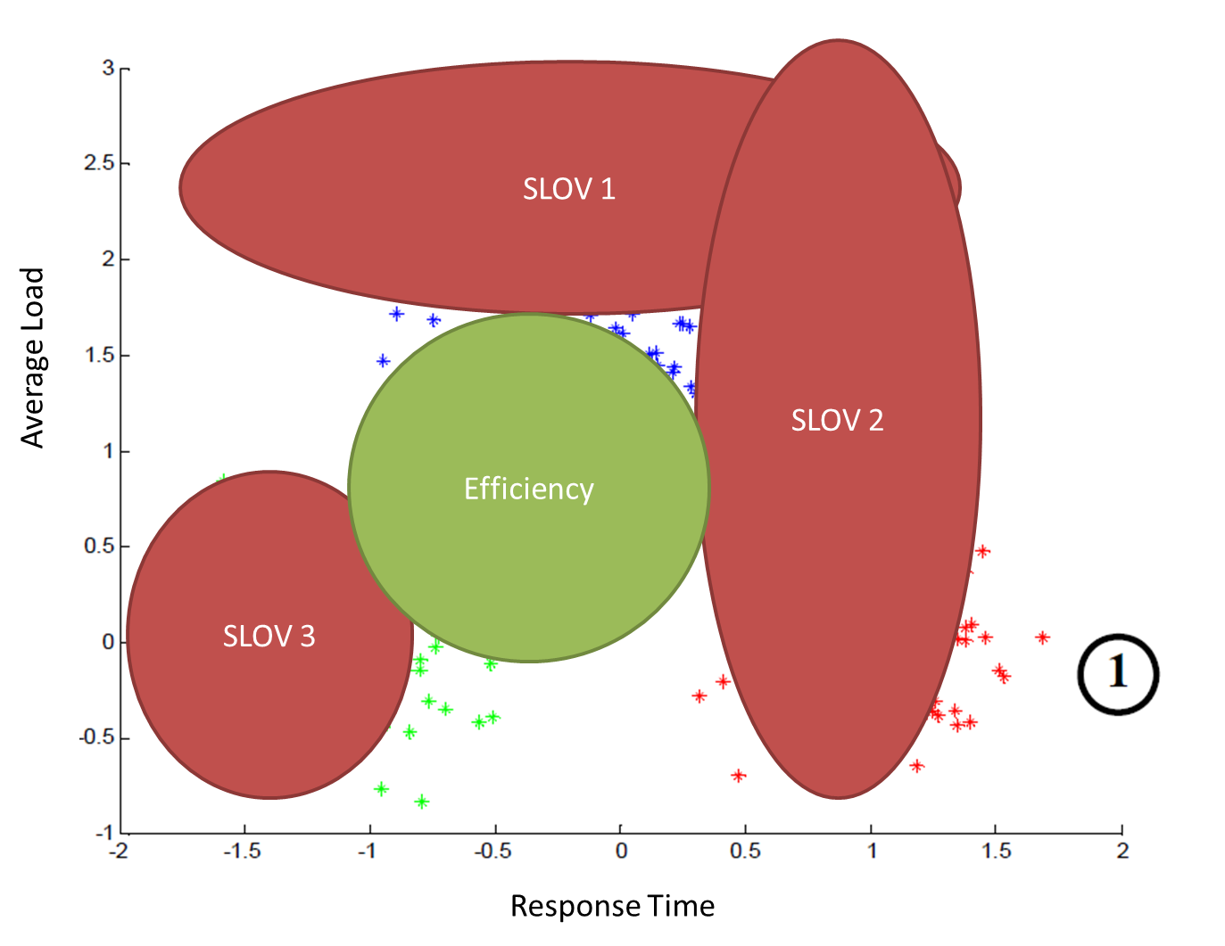

Slide 48
Acronym | Name | Definition
SLA | Service Level Agreement
SLO | Service Level Objective
SLOV | Service Level Objective Violation
SLAV | Service Level Agreement Violation
VNF | Virtual Network Function
DT | Decision Tree
MCDT | Multiclass Decision Tree
ABS | ANN-Based System
PCA | Principal component Analysis
RMSE | Root Mean Squared Error
TS | Time Series

